Slide 1
Chemical Kinetics

Slide 2
Chemical kinetics is the study of reaction rates, how reaction rates change under
varying conditions, and what molecular events occur during the overall reaction.
Chemical reactions require varying lengths of time for completion, depending on
the characteristics of reactants and products and the conditions under which the
reaction is run. Many reactions are over in a fraction of a second, whereas the
others can take much longer.
The rate or speed of any reaction may be affected by the following factors:
1. Concentration of reactant. Often the rate of reaction increases when the
concentration of a reactant is increased. The rate of burning increases with the
concentration of oxygen.
2. Concentration of catalyst. A catalyst is a substance that increases the rate of reaction without being consumed in the overall reaction. A solution of pure
hydrogen peroxide, H₂O₂, is stable, but when HBr (aq) is added, H₂O₂ decomposes

Slide 3
rapidly into H₂O and O₂. Here HBr acts as a catalyst to speed up decomposition.
3. Temperature at which the reaction occurs. Usually reactions speed up when the
temperature increases. Reactions during cooking go faster at higher temperature.
4. Surface area of a solid reactant or a catalyst. If a reaction involves a solid with a
gas or liquid, the surface area of the solid affects the reaction rate. A wood fire
burns faster if the logs are chopped into smaller pieces. Similarly, the surface area
of a solid catalyst is important to the rate of reaction. The greater the surface area
per unit volume, the faster is the reaction.
5. Radiations. The rates of certain reactions increase by the absorption of photons
of certain radiations. Such reactions are called photochemical reactions.
3O₂(g) (in presence of UV radiation ) → 2O₃(g)

Slide 4
Rate of reaction:
The rate of reaction is the amount of product formed or amount of reactant used up
per unit of time. Therefore, the reaction rate is the increase in molar
concentration of product of a reaction per unit time or the decrease in molar
concentration of reactant per unit time. The usual unit of reaction rate is
moles per liter per second, mol/L- s.
On heating dinitrogen pentoxide decomposes to nitrogen dioxide and oxygen.
2N₂O₅(g) → 4NO₂(g) + O₂(g)
For the above reaction, we can express the rate in terms of rate of formation of O₂,
∆[O₂]/ ∆T, we can also express in terms of the decomposition of N₂O₅, the rate of
decomposition of N₂O₅ = - ∆[N₂O₅]/ ∆T. The negative sign is always used in a rate
expression for a reactant in order to indicate a decrease in concentration and give
a positive value for the rate. Thus, ∆[N₂O₅] value is negative and - ∆[N₂O₅]/ ∆T is

Slide 5
positive.
Decomposition rate and formation rate are easily related. Two moles of N₂O₅ decompose for one mole oxygen formed. So, the rate of decomposition of N₂O₅ is twice the rate of formation of oxygen.
Rate of formation of O₂ = ½ (Rate of decomposition of N₂O₅)
∆[O₂]/ ∆T = - ½ ∆[N₂O₅]/ ∆T
for a general reaction, 2A + B → C + 3D
½ r_{A} = r_{B} = r_{C} = ⅓r_{D}
Dependence of rate on concentration:
Experimentally, it has been found that a reaction rate depends on concentrations of the reactants as well as the concentration of catalyst. Consider the following reaction,
2NO₂(g) + F₂(g) → 2NO₂F(g) (nitryl fluoride)
The rate of this reaction is observed to be proportional to the concentration of nitrogen dioxide. When the concentration of nitrogen dioxide is doubled,

Slide 6
the rate doubles. The rate is also proportional to the concentration of fluorine;
doubling the concentration of fluorine also doubles the rate.
A rate law is an equation that relates the rate of a reaction to the concentrations
of reactants (and catalyst) raised to various powers. The following equation is the
rate law of the above reaction:
Rate = k[NO₂][F₂]
Note that in this rate law both reactant concentrations have an exponent of 1.
Here, k is called the rate constant. It has a fixed value at a given temperature.
The unit of k in this case is [mol/(L-s)]/(mol/L)² = L/(mol-s)
For a reaction, aA + bB → cC + dD
The rate law equation is; Rate = k [A]^{m}[B]^{n} , the exponents m and n are frequently,
but not always, integers. They must be determined experimentally and they can not
be obtained simply by looking at the balanced equation.

Slide 7
Reaction order:
A reaction can be classified by its order. The reaction order with respect to a
given reactant species equals the exponent of the concentration of that species
in the rate law, as determined experimentally. For the reaction of NO₂with F₂ to
[2NO₂(g) + F₂(g) → 2NO₂F(g) (nitryl fluoride) ; Rate = k[NO₂][F₂] (rate law)]
give NO₂F, the reaction is first order with respect to NO₂ because the exponent
of [NO₂] in the rate law is 1. Similarly the reaction is first order with respect to F₂.
The overall order of the reaction is the sum of the orders of the reaction species
in the rate law. In this example, the overall order is 2; that is the reaction is second
order overall.
For a reaction, 2NO(g) + 2H₂(g) → N₂(g) + 2H₂O(g)
the experimentally determined rate law is, Rate = k[NO]²[H₂]
Thus, the reaction is second order in NO, first order in H₂ and third order overall.

Slide 8
Molecularity: Elementary or simple reactions are classified according to their
molecularity. Molecularity is the number of molecules on the reactant side of
an elementary reaction. A unimolecular elementary reaction involves one reactant
molecule, a bimolecular reaction involves two reactant molecules and a termolecular reaction involves three molecules. Higher molecularities are not
usually encountered. Examples:
(a) NO + O₃ → NO₂ +O₂ (b) NOCl₂ + NO → 2NOCl (c) O₃ → O₂ + O
(d) Cl₂ ↔ 2Cl
Ans. (a) bimolecular; (b) bimolecular; (c) unimolecular and (d) forward one is
unimolecular and back one is bimolecular.
Rate equation for an elementary reaction: For an elementary reaction, the rate is
proportional to the product of the concentration of each reactant molecule.
For a reaction, A → B +C; Rate = k[A]; for A+B → C+D; Rate= k[A][B].

Slide 9
Molecularity Order
1. No. of molecules taking part in the 1. The order with respect to a given
elementary reaction give products. reactant species equals the exponent
of the concentration of species in the
rate law as determined experimentally.
2. The reaction is simple/elementary. 2. The reaction may be elementary or
complex.
3. Always integer(1,2,3 etc). 3. Fraction/ integer ( ½,,1,2, etc).
4. Never zero. 4. May be zero.
Determination of Rate law: The experimental determination of the rate law for a
reaction consists of doing a series of experiments in which the initial or starting
concentrations of reactants are varied. Then the rates are compared, from which the
reaction orders can be deduced.

Slide 10
Example 1. Determination of rate law of the following reaction:
2NO(g) + 2H₂(g) → N₂(g) + 2H₂O(g)
The theoretical rate law of this reaction is, Rate = k[ NO]^{X} [H₂]^{y}
Expt. no. [NO] (M) [H₂] (M) initial rate(M/s)
1 0.0050 0.0020 1.25X10⁻⁵
2 0.0100 0.0020 5.0X10⁻⁵
3 0.0100 0.0040 1.0X10⁻⁴
comparing expt. 1&2, [H₂] is constant; ↑[NO]X2^{X} Rate,↑RX4 or RX2²
therefore, X = 2 and the rate law, R = k [ NO]² i.e. with respect to [NO],
the reaction is second order.
comparing expt. 2&3, [NO] is constant; ↑[H₂]X2^{Y} Rate,↑RX2 or RX2¹
therefore, Y=1 and the rate law, R = k [H₂]¹ i.e. with respect to [H₂],
the reaction is first order.
The overall Rate is: Rate, R = k[NO]² [H₂]¹ and the overall order is 2+1=3.

Slide 11
Example 2. Determination of rate law of the following reaction:
2N₂O(g) → 2N₂(g) + O₂(g)
Theoretical rate law, Rate = k[N₂O]^{X}
Expt. no. [N₂O] (M) initial rate(M/s)
1 0.100 1.00X10⁻³
2 0.200 1.00X10⁻³
3 0.300 1.00X10⁻³
↑[N₂O]X2^{X} ↑RX2⁰
therefore, x=0 and the rate law, R = k[N₂O]⁰ i.e. the reaction is zero order.
R = k[N₂O]⁰ or R = k, i.e. the rate is equal to the rate constant.

Slide 12
Example-3: For the following reaction determine the rate law,
NO₂(g) + CO(g) → NO(g) + CO₂(g)
Theoretical rate = k[NO₂]^{m}[CO]^{n}
Expt. [NO₂](M) [CO](M) Initial rate (M/s)
1 0.100 0.050 2.00x10⁻²
2 0.200 0.050 4.00x10⁻²
3 0.400 0.050 16.0x10⁻²
4 0.400 0.100 16.0x10⁻²
Comparing expt. no. 2 & 3, [CO] kept constant, ↑[NO₂]x2^{m} ↑Rx4 or Rx2² ; m=2
therefore, the order of reaction with respect to NO₂ is 2 i.e. second order.
Comparing 3 & 4, [NO₂] kept constant [CO] varies, ↑[CO]x2^{n} ↑Rx2⁰ ; n=0
therefore, the order of reaction w.r.t. CO is 0 i.e. zero order
The rate law of overall reaction, R = k[NO₂]²[CO]⁰ = k[NO₂]² (2nd order reaction )

Slide 13
Integrated rate law
For first order reaction:
A → Product
Rate, R = ─ ∆[A] /∆t ( Average rate) ; R = k[A]¹
Instantaneous rate (rate of change), ─ d[A] /dt = k[A]¹ or d[A]/[A] = ─kdt
Integrating, ʃ d[A]/[A] = ─ ʃ kdt t=0, [A] = [A]₀
or ʃ d[A]/[A] = ─ k ʃdt t=t, [A] = [A]_{t}
or ln [A]_{t} ─ ln [A]₀ = ─ kt This is the integrated rate law of first order reaction.
or ln [A]_{t} = ─ kt + ln [A]₀ (another form of rate law)

Slide 14
Determination of rate constant, k (First order)
The rate equation, ln [A]_{t} = ─ kt + ln [A]₀
ln[A] Slope = - k
so, the rate constant, k can be
determined from the slope.
t

Slide 15
Half-life of a first order reaction
ln [A]_{t} ─ ln [A]₀ = ─ kt
Rearranging log( [A]_{t} / [A]₀)= ─ kt/2.302
or t = {log ([A]₀/[A]_{t} )} 2.302/k
when t = t_{1/2} ; [A]_{t} = [A]₀/2
therefore, t_{1/2} = (2.302/k(log2)
or t_{1/2} = 0.693/k
Half- life of a first order reaction is independent of concentration.
The half-life, t_{1/2}, of a reaction is the time it takes for the reactant concentration
to decrease to one-half of its initial value. We know from the rate law,

Slide 16
Integrated rate law for second order reaction
For second order reaction:
A → Product
Rate, R = ─ ∆[A] /∆t ( Average rate) ; R = k[A]²
Instantaneous rate (rate of change), ─ d[A] /dt = k[A]² or ─ d[A]/[A]²= kdt
Integrating, ─ ʃ d[A]/[A]²= ʃ kdt t=0, [A] = [A]₀
or ─ ʃ d[A]/[A]²= k ʃ dt t=t, [A] = [A]_{t}
or ─ ʃ [A]⁻² d[A] = k ʃdt
evaluating from [A]₀ to [A]_{t}
1/[A]_{t} ─1/[A]₀ = kt
This is the integrated form of rate law of second order reaction.
or 1/[A]_{t} = kt + 1/[A]₀ (another form of rate law)

Slide 17
Rate law for second order reaction, 1/[A]_{t} = kt + 1/[A]₀
1/[A] slope = k (rate constant)
t

Slide 18
Half-life of a second order reaction
Rate law of a second order reaction : 1/[A]_{t} ─1/[A]₀ = kt
when t = t_{1/2} ; [A]_{t} = [A]₀ /2
so, 1/ {[A]₀ /2} ─1/[A]₀ = k t_{1/2}
or 2/[A]₀ ─1/[A]₀ = k t_{1/2}
or 1/[A]₀ = k t_{1/2}
or t_{1/2} = 1/(k[A]₀)
2nd half-life of a second order reaction:
t_{1/2} = 1/(k[A]₀ /2) = 2/(k[A]₀)
2nd half-life is twice the 1st half-life, similarly the 3rd half-life will be twice the 2nd
half-life . As the concentration or amount decreases, time taken increases.

Slide 19
For zero order reaction:
A → Product
Rate, R = ─ ∆[A] /∆t ( Average rate) ; R = k[A]⁰
Instantaneous rate (rate of change), ─ d[A] /dt = k[A]⁰ or ─ d[A]= kdt
Integrating, ʃ d[A]= ─ ʃ kdt t=0, [A] = [A]₀
or ʃ d[A] = ─ k ʃ dt t=t, [A] = [A]_{t}
evaluating from [A]₀ to [A]_{t}
[A]_{t} ─[A]₀ = ─ kt
this is the rate law for zero order reaction.
or [A]_{t} = ─ kt + [A]₀
slope = -k
[A] (rate constant, k can be determined)
t

Slide 20
Half- life of a zero order reaction
The rate law is ; [A]_{t} = ─ kt + [A]₀
when t = t_{1/2} ; [A]_{t} = [A]₀/2
so, [A]₀/2 ─ [A]₀ = ─ k t_{1/2}
or ─ [A]₀/2 = ─ k t_{1/2}
or [A]₀/2 = k t_{1/2}
or t_{1/2} = [A]₀/2k
As [A]₀ increases, t_{1/2} increases
An example of a zero order reaction: 2NH₃(g) → N₂(g) + 3H₂(g)
Rate, R = k[NH₃]⁰
R = k (rate constant)

Slide 21
Pseudo-unimolecular reaction:
A reaction of the type, A + B → Product (elementary reaction)
It is theoretically a bimolecular and overall second order reaction. the rate law is
Rate = k[A]¹[B]¹
If the concentration of any of the reactant (say B) is much larger than that of the other, then it is clear that during the reaction, the concentration of B does not
alter appreciably i.e. the concentration of B remains essentially constant. The
rate law then becomes, R = - d[A]/dt = k’[A] , where k’ is a new constant known as
pseudo-first order rate constant. Thus the reaction is apparently first order in A,
zero order in B and overall reaction is first order.
Example: Hydrolysis of ethyl acetate, CH₃COOC₂H₅ + H₂O ----- (H+)--- → CH₃COOH + C₂H₅OH
In this reaction, one of the reactant (H₂O) is present in large excess and

Slide 22
concentration of water does not alter appreciably during the reaction. Such type
of reactions which is though bimolecular yet following the kinetics of first order
are called Pseudo-unimolecular reactions.
The rate law of the above reaction is,
Rate = k[CH₃COOC₂H₅]¹

Slide 23
Collision Theory:
The rate constant depends on temperature. This can be explained with the help
Collision Theory. It is a theory that assumes that, for a reaction to occur, reactant
molecules must collide with an energy greater than some minimum value and
with the proper orientation. The minimum energy of collision required for two molecules to react is called Activation Energy, E_{a}.
In collision theory, the rate constant for a reaction is given as a product of three
factors: (1) Z, the collision frequency, (2) f, the fraction of collisions having energy
greater than the activation energy, and (3) p, the fraction of collisions that occur
with the reactant molecules properly oriented. Thus,
k = Zfp
Let us consider a gas-phase reaction of NO with Cl₂ to produce NOCl and Cl.
The reaction is believed to occur in a single step. An NO molecule collides with a

Slide 24
Cl₂ molecule. If the collision has sufficient energy and if the molecules are properly oriented, they react to produce NOCl and Cl.
Collision frequency, Z , the frequency with which the reactant molecules collide, depends on temperature. As the temperature rises, the gas molecules move faster and collide more frequently. Therefore, the rate would increase with temperature as the collision frequency increases. The collision frequency varies slowly with temperature. However, f, the fraction of molecular collisions having energy greater than the activation energy, changes rapidly in most reaction even with small temperature changes. It can be shown that f is related the activation energy, E_{a}, this way:
f = e^{-Ea/RT}
from the equation, we see that f decreases with increasing value E_{a}. Because the rate
constant depends on f, means the reaction with large activation energy have small
rate constants and that reactions with small activation energy have large rate constants.
It also shows that the increase of temperature, increases the rate constant.

Slide 25
The reaction rate also depends on p, the proper orientation of the reacting molecules when they collide. This factor is independent of temperature changes.
Two possible molecular collisions are shown below:
(i) O = N →← Cl ─ Cl → O = N ─ Cl + Cl
(ii) N = O →← Cl ─ Cl → N = O , Cl ─ Cl
In (i) the NO and Cl₂ molecules are properly oriented for collision resulting the
products NOCl and Cl. In (ii) the NO molecule approaches with its O atom towards
Cl₂ molecule. Because this orientation does not allow the formation of a bond
between the N atom and Cl atom, it is ineffective for reaction. The molecules come
together and then fly apart. All orientations except those close to that shown in (i)
are ineffective.

Slide 26
Transition-state Theory
Transition-state theory explains the reaction resulting from the collision of two molecules in terms of an activated complex. An activated complex (transition)
is an unstable grouping of atoms that can break up to form products. We can
represent the formation of activated complex this way:
A + BC ← [A---B----C] → AB + C
reactants activated complex products
When the molecules come together with proper orientation, the kinetic energy
of the collision is absorbed by the activated complex as a vibrational motion of atoms . This energy becomes concentrated in the bond denoted by the dashed
lines can flow between them. If, at some moment, sufficient energy becomes
concentrated in one of the bonds of the activated complex, that bond breaks or
falls apart. Depending on whether the A---B or B----C bond breaks, the activated
complex either reverts to the reactants or yields the products.

Slide 27
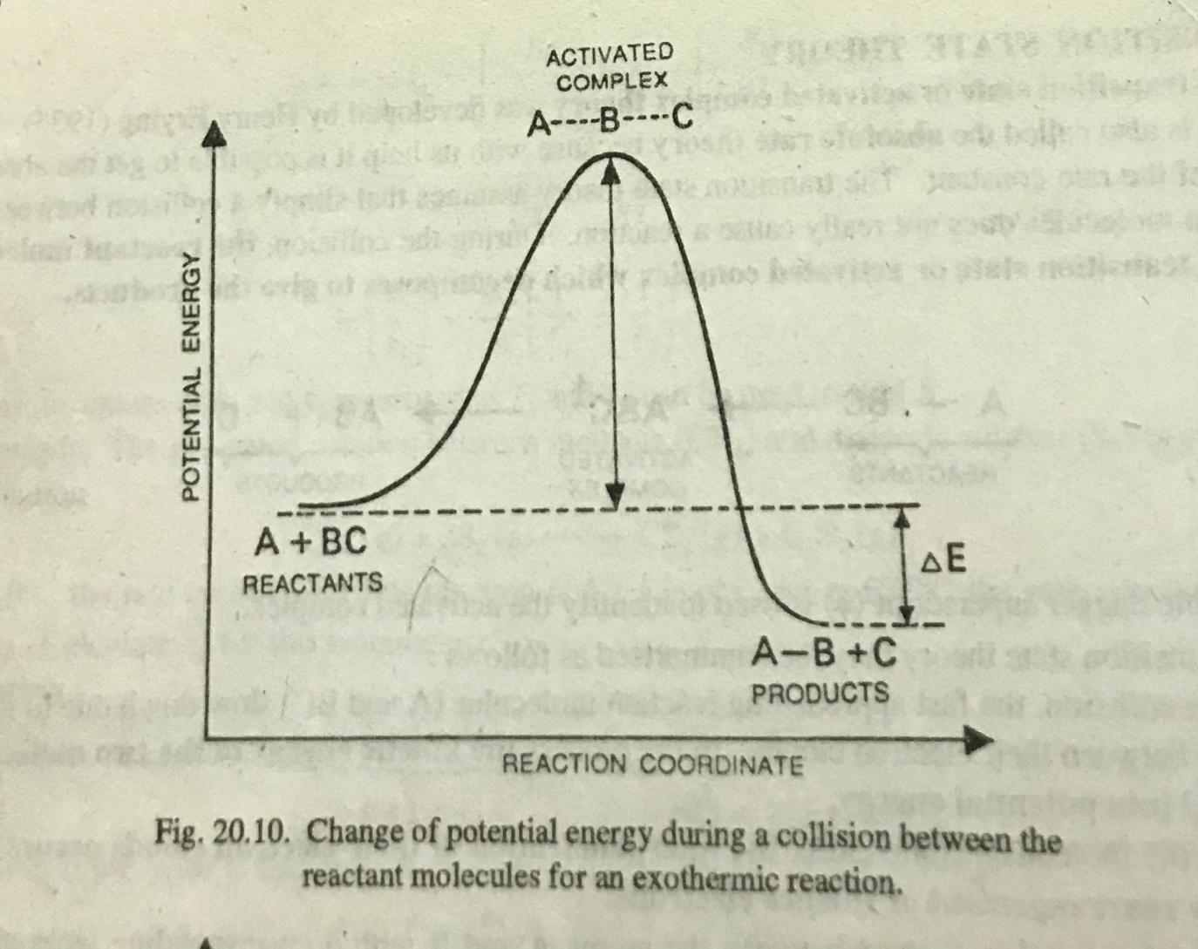

Slide 28
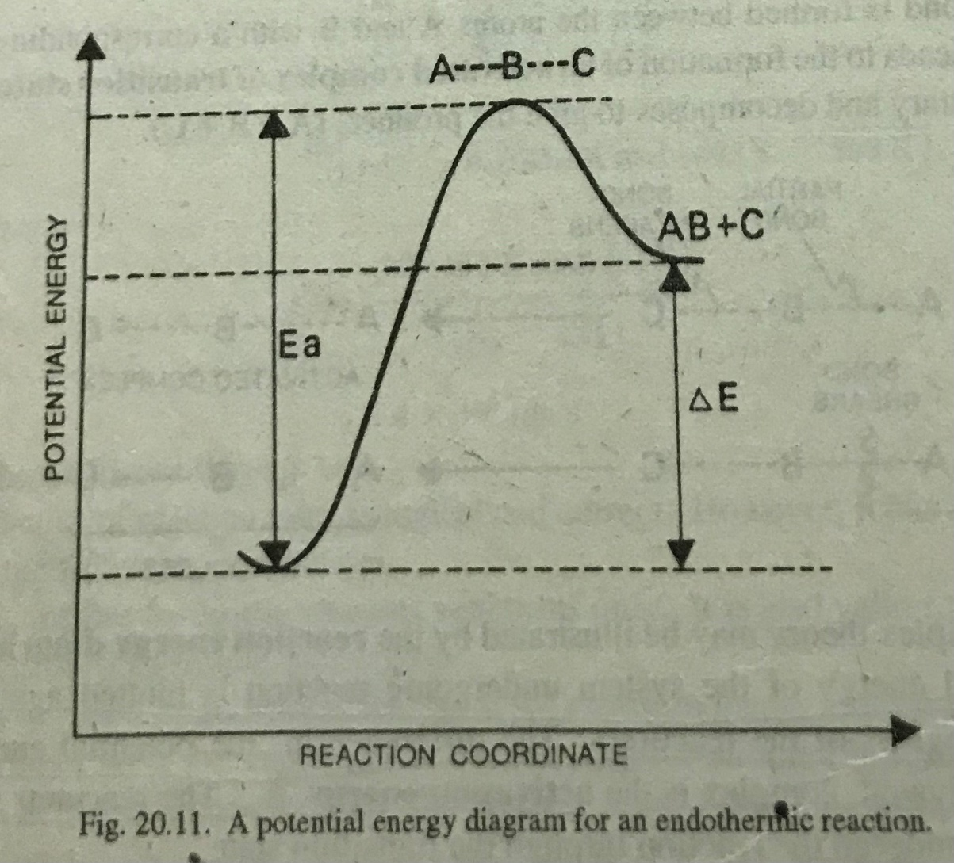

Slide 29
The above potential energy diagrams for the reactions can be represented by the
equation: A + BC → [A---B----C] → AB + C
The 1st figure shows the change in potential energy that occurs during the progress
of the reaction. The potential-energy curve starts at the left with the potential
energy of the reactants, A+BC. Moving along the curve toward the right, the
potential energy increases to a maximum, corresponding to the activated complex.
Further to the right, the potential energy decreases to that of the product, AB+C.
As the reaction progresses (from left to right), the potential energy increases
because the outer electrons of the two molecules repel. If the reactant molecules
have sufficient KE it is possible for the potential energy to increase to the value for the
activated complex. The energy must be equal or greater than the difference in
energy between the activated complex and the reactant molecules. the energy
difference is the activation energy for the forward reaction.

Slide 30
At the maximum in the potential-energy curve, the reactant molecules have come
together as the activated complex. When the activated complex breaks up into
products, the products go to the lower potential energy. Note that the energy of
the products is lower than the energy of the reactants. The difference in energy
equals the heat of reaction, ∆H. Because the energy of the reactants is higher than that of the products, the heat energy is released and ∆H is negative. Therefore, the reaction is exothermic.
Second figure shows the potential-energy curve for endothermic reaction. In this
case, the energy of the products is higher than the energy of the reactants.
Because the energy increases, ∆H is positive and the reaction is endothermic.

Slide 31
Arrhenius Equation:
The mathematical equation k = Ae^{-Ea/RT}, which expresses the dependence of the
rate constant on temperature, is called Arrhenius equation. Here R is the gas
constant, 8.31J/(K-mol) and T is absolute temperature. The symbol A in the
equation, which is assumed to be a constant, is called the frequency factor. The
frequency factor is related to the frequency of collision with proper orientation(pZ).
It is useful to recast Arrhenius equation in logarithmic form. Taking the natural
logarithm of both sides of the Arrhenius equation gives
ln k = ln A – E_{a} /RT
expressing in terms of logarithms to the base 10,
log k = log A – E_{a} /2.303RT
This is an equation of a straight line, so, if we plot log k against 1/T, should get
a straight line and the slope of the line is - E_{a} /2.303R, from which we can

Slide 32
obtain the activation energy, E_{a}. The intercept is log A.
log k slope = - E_{a} /2.303R
1/T
We can write the equation at two different temperatures, T₁ and T₂ for the two
rate constants k₁ and k₂ respectively. The equations are:
log k₁ = log A - E_{a} /2.303RT₁
log k₂ = log A - E_{a} /2.303RT₂

Slide 33
Subtracting the equations,
log k₂ – log k₁ = - E_{a} /2.303RT₂ + E_{a} /2.303RT₁
or log(k₂ / k₁) = (E_{a} /2.303R)[(1/T₁) – (1/T₂)], this is another form of
Arrhenius equation. The equation is useful for determining rate constant at
different temperature.
-------------------

Slide 34
Rate law and mechanism
Mechanism is the sequence of elementary steps by which a reaction proceeds.
The mechanism of a reaction is first predicted , then the rate law of overall reaction
of the predicted mechanism is verified with the experimental rate law. If two rate
laws are same, then the mechanism predicted for the reaction is taken as correct.
Let us take an example,
NO₂(g) + CO(g) → NO(g) + CO₂(g)
The above reaction does not take place in one step. So, we predict a mechanism:
elementary step 1; NO₂ + NO₂ → NO + NO₃
elementary step 2; NO₃ + CO → NO₂ + CO₂
The overall reaction is : NO₂ + NO₂ + NO₃ + CO → NO + NO₃ + NO₂ + CO₂
or NO₂ + CO → NO + CO₂ (NO₃ is an intermediate)

Slide 35
The experimental rate law of the reaction is:
R = k[NO₂]²
according to the rate law the reaction is second order and it is with respect to
[NO₂]. In the overall reaction the coefficient of NO₂ is 1, and we can not take the
exponent as 1. So, from the balanced equation we can not predict the rate law. Moreover, according to the experimental rate law, the reaction is zero order with respect to CO.
Now let us look into the mechanism of the reaction,
elementary step 1 NO₂ + NO₂ → NO + NO₃ (slow step)
elementary step 2 NO₃ + CO → NO₂ + CO₂ (fast step)
The slow step is always called the rate determining step. The reason why it is
rate determining step, suppose, elementary step 1 occurs in 1 second and the

Slide 36
elementary step 2 occurs in 1x10⁻⁸ second. So, the total time is almost equal to
1 second i.e. the time taken for the slow step to occur. Therefore, the rate law is,
R = k[NO₂]¹[NO₂]¹
or R = k[NO₂]²
In the rate determining step there is now no CO term. So, the reaction is zero
order with respect to CO.
Therefore, the mechanism predicted is justified because the rate law of predicted
mechanism is the same as the experimental rate law.

Slide 37
Example 2: A reaction, 2NO + O₂ → 2NO₂
The reaction does not occur in a single step. Let us predict the possible
mechanism of the reaction as below:
elementary step 1 ; 2NO → N₂O₂ (fast)
elementary step 2; N₂O₂ +O₂ → 2NO₂ (slow)
Overall reaction: 2NO + N₂O₂ + O₂ → N₂O₂ + 2NO₂
or 2NO + O₂ → 2NO₂
According to rate determining step (slow), the rate law, R = k[N₂O₂]¹[O₂]¹, but there
is no N₂O₂ in the overall reaction. Since N₂O₂ has been produced from 2NO of step 1,
2NO will be considered in place of N₂O₂ in the rate expression.
Therefore the rate expression, R = k[NO]²[O₂]¹ ; the overall order is 3 (third order).

